Slide 1

FPT EDUCATION
Practices for KIT Arduino Uno R3
Version 1.0

Slide 2
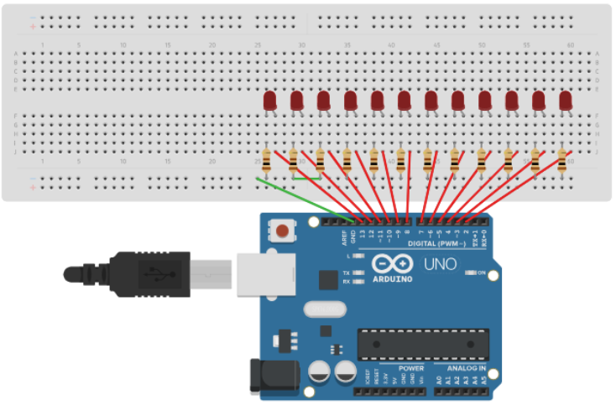
Lab#1: LED Array Effect

Slide 3
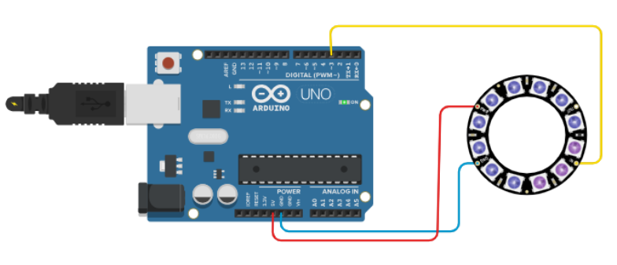
Lab#2: LED RGB

Slide 4
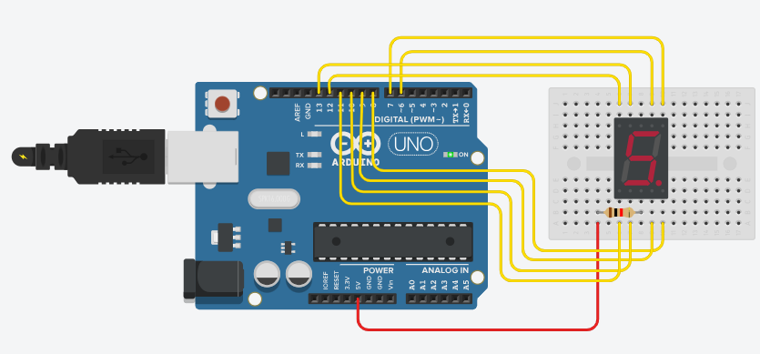
Lab#3: Display LED 7-Segment

Slide 5
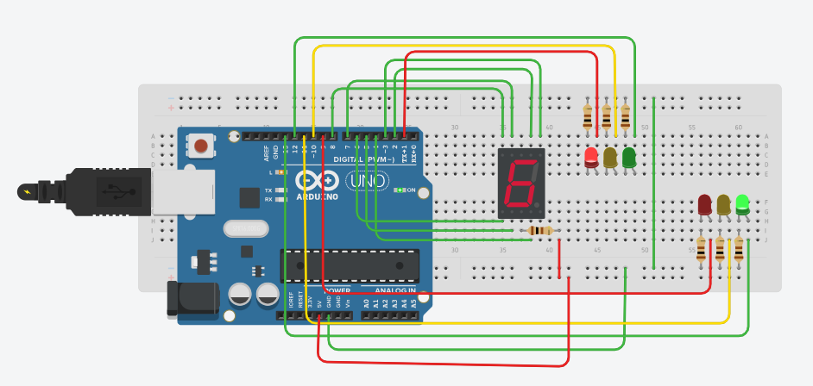
Traffic Lights
https://www.tinkercad.com/things/8JE4PmnwByT-brave-gogo-amberis/editel?sharecode=OzkadXeKdVSWY3wMrYutHkvNilSSjyDwhTcC6XlV890

Slide 6
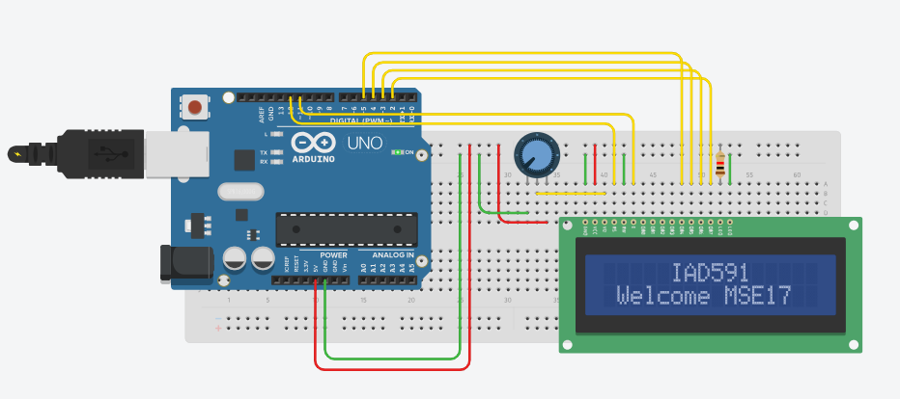
Lab#4: Display LCD1602
https://www.tinkercad.com/things/4mxk7FfAYSi-basic-lcd1602/editel?sharecode=hvTNN3CIe3TBG1GH-nabHKYH6dHmL9H464miL8wAU_A

Slide 7
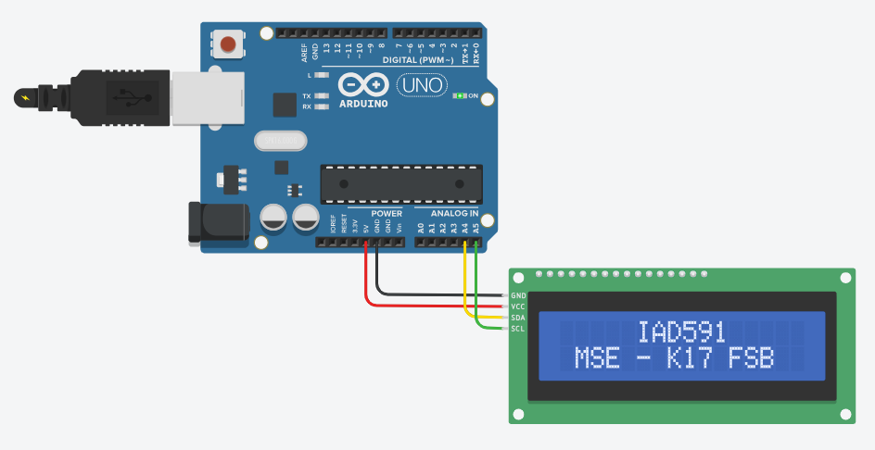
Lab#5: Display LCD1602 Use I2C

Slide 8
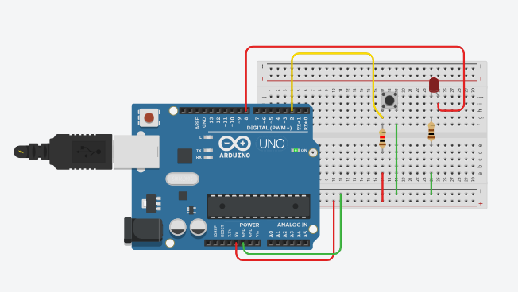
Lab#6: Digital input

Slide 9
Lab#7: Sound Sensor

Slide 10
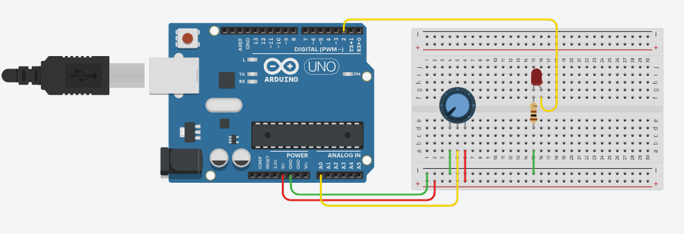
Lab#8: Analog input

Slide 11
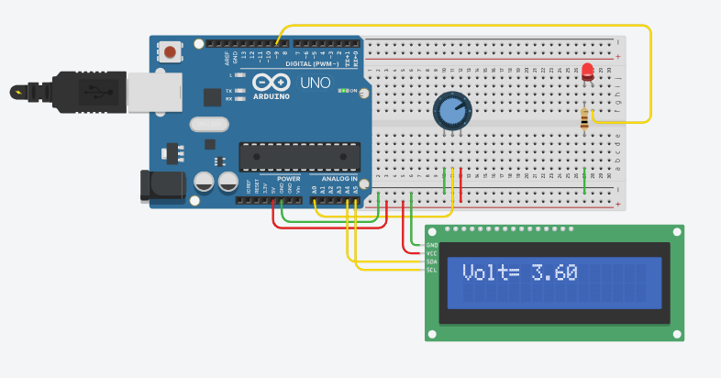
Lab#9: Volt Display on LCD1602

Slide 12
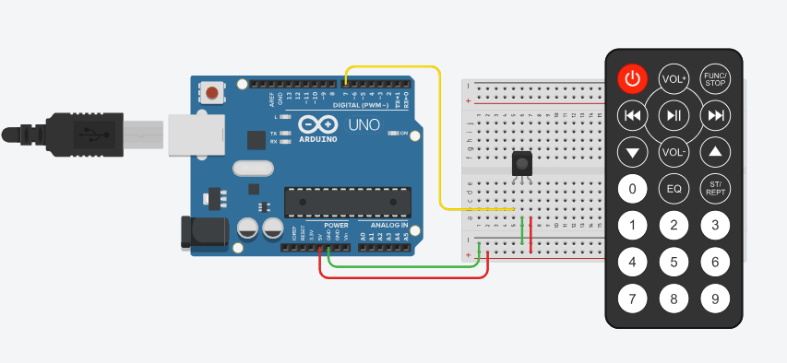
Lab#10: IR Remote

Slide 13
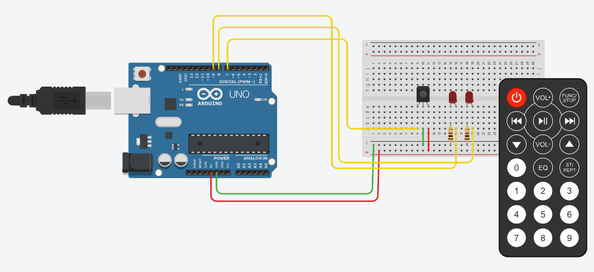
Lab#11: On/Off Device use IR Remote

Slide 14
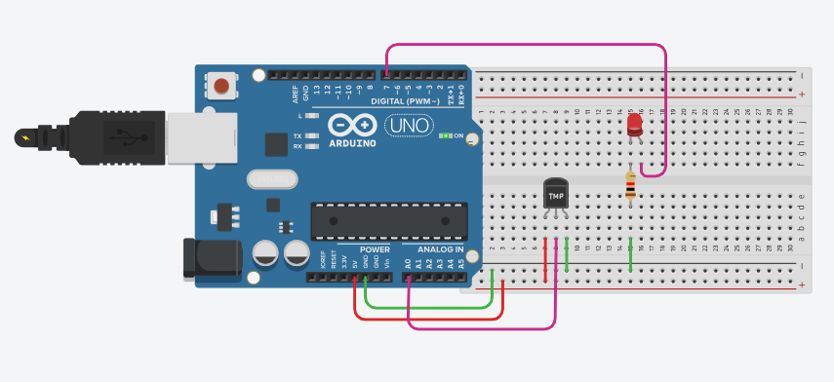
Lab#12: Temperature Sensor LM35/TMP

Slide 15
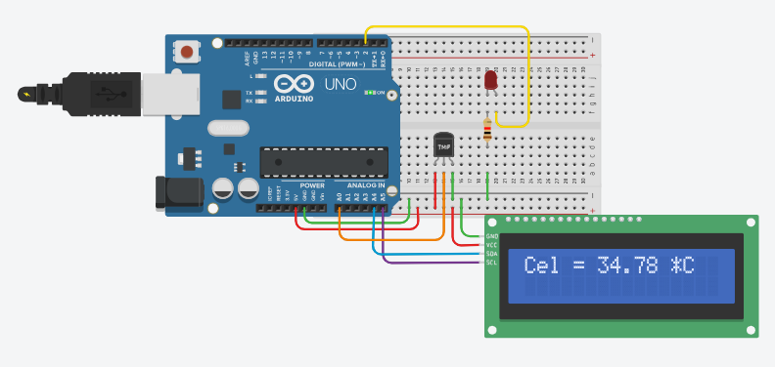
Lab#13: Sensor LM35/TMP And LCD1602

Slide 16
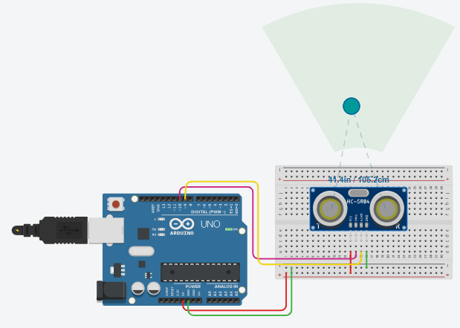
Lab#14: Ultrasonic Distance Sensor

Slide 17
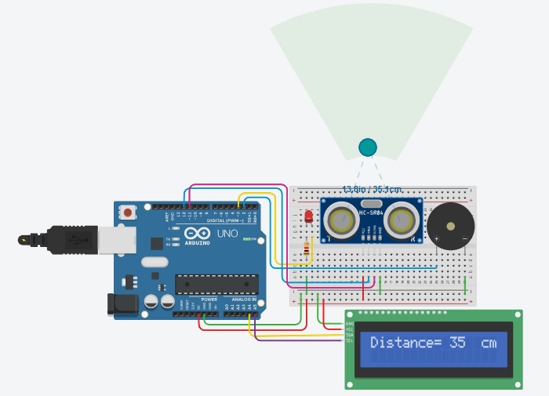
Lab#14: Ultrasonic Distance Sensor

Slide 18
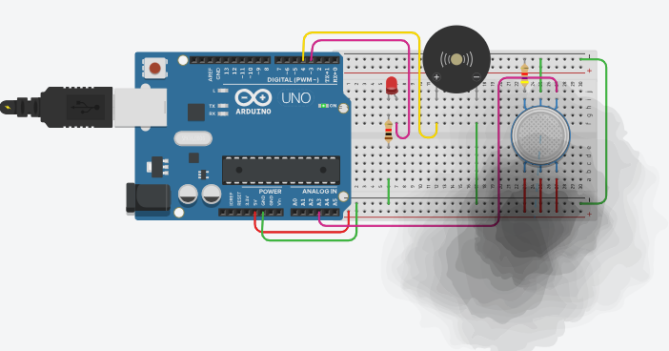
Lab#15: GAS Sensor

Slide 19
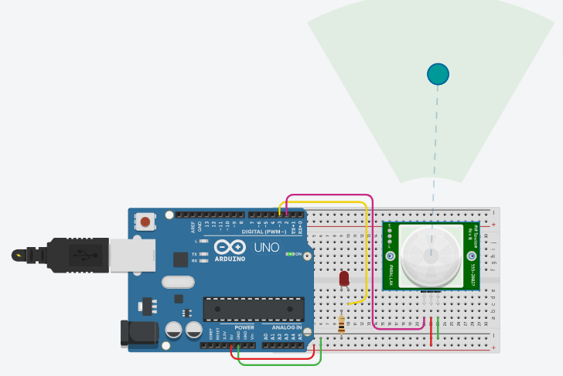
Lab#16: PIR Sensor

Slide 20
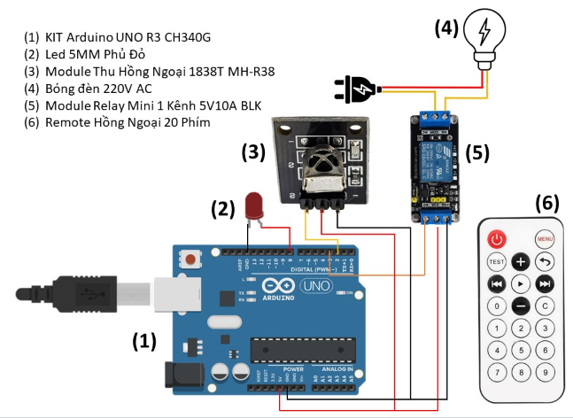
Applications

Slide 21
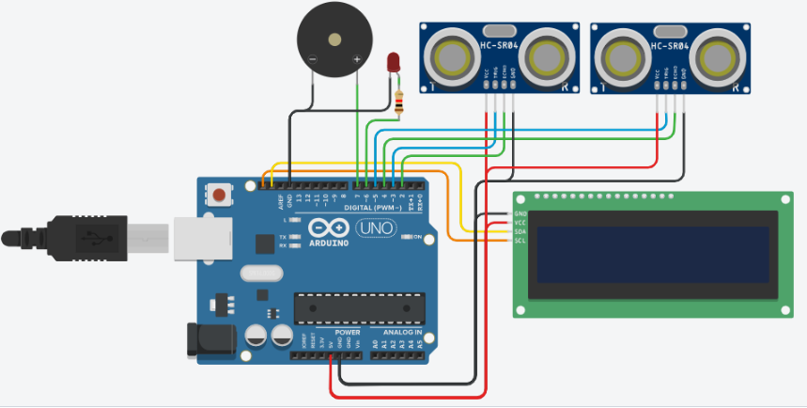
Applications

Slide 22
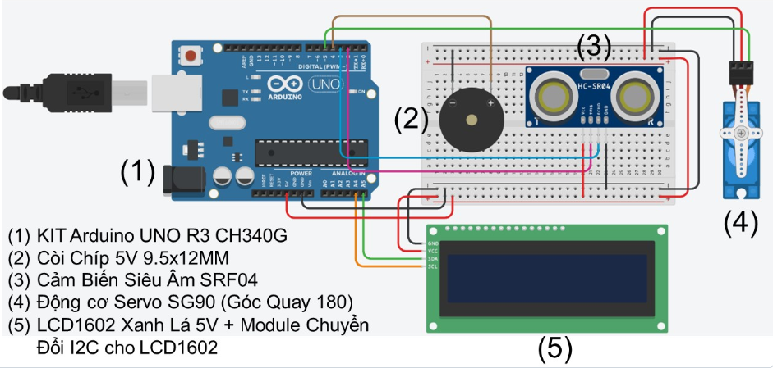
Applications

